Slide 1
PPM szoftver trendek
Németh János Pál
Gartner Executive Partner
PMSZ 20. Körkapcsolás
2013. október 17.
Notes:
Well-Rounded PPM From Start to Finish via the PMO
PPM & IT Governance Summit
May 20-22, 2013
Gaylord National
National Harbor, MD
Matt Light
This presentation, including any supporting materials, is owned by Gartner, Inc. and/or its affiliates and is for the sole use of the intended Gartner audience or other authorized recipients. This presentation may contain information that is confidential, proprietary or otherwise legally protected, and it may not be further copied, distributed or publicly displayed without the express written permission of Gartner, Inc. or its affiliates.
© 2013 Gartner, Inc. and/or its affiliates. All rights reserved.
Notes accompany this presentation. Please select Notes Page view.
These materials can be reproduced only with written approval from Gartner.
Such approvals must be requested via email: vendor.relations@gartner.com.
Gartner is a registered trademark of Gartner, Inc. or its affiliates.

Slide 2
A PPM érettségi modell (Maturity Model) dimenziói
5. szint
4. szint
Effective
Innovation
3. szint
Effective
Integration
2. szint
Initial
Integration
1. szint
Emerging
Discipline
Emberek
Reactive
PPM gyakorlatok
és folyamatok
Technológia
Pénzügyi
menedzsment
Kapcsolatok
Fejlődés
Notes:
Assumptions underlying a maturity model:
Capabilities and dimensions develop over time.
Improvements are built on an increasing mastery of incremental steps.
Many models assume that the various capabilities interrelate and support one another and, therefore, must be improved simultaneously.
Current capabilities can be assessed against an objective standard, and areas for improvement can be planned. Use KPIs appropriate to core capabilities and maturity level, and then allow for appropriate
fine-tuning along the way.
Key Findings
■ The Program and Portfolio Management (PPM) Maturity Model is centered around
organizational maturity, rather than incremental and possibly artificial process improvement,
because good process means nothing if the organization cannot execute on it.
■ Advancing from one maturity level to another means that more-complex and higher-value
interactions can take place with the same amount of effort — that is, what was once difficult
becomes simpler with time and experience.
■ PPM maturity advances through actions that affect organizational culture, individual capabilities
and the organization's aggregate capability. At various levels of maturity, the importance of
each of these three factors changes.1
Recommendations
■ Create practices and processes that are mutually reinforcing, such as insisting on capturing and
tracking time to better understand and balance workloads.
■ Upon reaching Level 3, organizations can plateau after achieving significant improvement from
their starting point. Discuss with stakeholders whether this level of performance is sufficient to
meet future challenges.
■ For organizations that require enterprisewide change and capabilities, it is worth the effort to
pursue Level 4 where enterprise PPM practices are built.
■ Use the five dimensions of the PPM Maturity Model to help determine the next actions that are
appropriate, practical and valuable to your organization.

Slide 3
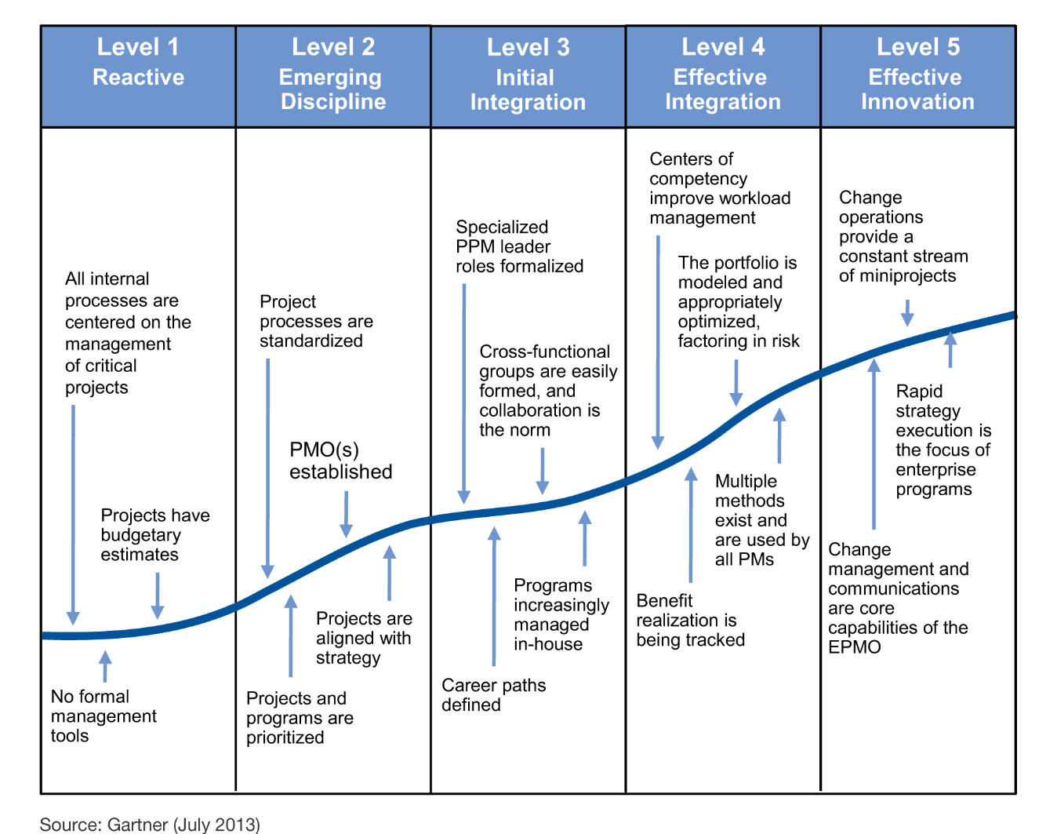
A PPM érettségi modell 5 szintje
Notes:
Level Descriptions
Level 1: Reactive
No organization consciously chooses to be at a Level 1 maturity. Generally, some external event
such as rapid growth, change in market conditions or a merger/acquisition causes the organization
to lumber out of its previous state (which is generally unconscious competence) like a bear
awakening from hibernation (see Note 1).
In this initial stage, the organization is more reactive than proactive when dealing with projects. The
PPM role is nonexistent or just emerging, solely because someone on staff brought the knowledge
into the organization. Personal relationships form the foundations of informal "adhocracies."
Consequently, processes and projects tend to revolve around specific individuals who are generally
viewed as heroes or superachievers (see Note 2). Internal processes are centered on managing
critical projects, so priority projects get staffing support, but all else is on the first-available
schedule. Larger projects, when they are absolutely necessary, are contracted out to vendors.
Projects may have budgetary estimates, but quite often, the project work is simply funded out of the
IT or other departmental budget. Technology tools for projects are generally limited to spreadsheets
and, occasionally, a project-scheduling tool used by an individual PM.
Level 2: Emerging Discipline
Level 2 is defined as an "emerging discipline," because this is the point where the organization
decides that the plate spinning and ball juggling of Level 1 simply can't go on anymore, and that
slowing down just long enough to get organized is a make-or-break situation. Depending on how
long an organization stayed at Level 1, and depending on its culture, Level 2 can be a massive
swing of the pendulum from an "anything goes, just get it done" environment to a process-driven,
moribund organization where rules get followed, and nothing gets done at the most extreme level.
Most organizations at this level have invested in a basic PPM tool. The concept of disciplined teams
working on a project is developed, and project collaboration and team workspaces are supported.
Nevertheless, "stovepiped" systems and inconsistent data still bedevil business processes. Tools
for value financial management are generally still rudimentary, with little or no capacity to provide a
detailed look into multiple projects or programs, or to handle chargeback or allocation systems.
Level 3: Initial Integration
The most useful competency for a PPM function at Level 3 is the ability to think holistically, focusing
on the whole, and not the parts. This entails being able to understand how a change in one area will
affect others, how changes should be made and in what order to achieve maximum results. Level 3
concentrates on just enough of everything to get things working. It's not perfection, but it is the
beginning of a state of conscious competence (see Note 3).
One of the most significant changes that happen at Level 3 is the creation of true joint decision
making about projects and programs by the organization as a whole. We hesitate to call this
"transparent governance," because it's a term often used by Level 2 organizations to set up
something that is neither true governance nor transparent. The goal at this level is to provide a
portfolio perspective so that the entire management structure of the organization can understand
what investments are being made, what the outcomes and benefits are, and what the probability of
success is. This need for transparent decision making creates a situation where there is a need for
tools to provide visibility and support analysis; there is also a need for a reliable delivery mechanism
and for some level of financial accountability. The reason this level is known as initial integration is
that, while there is a need for everything to begin to work in harmony, Level 3 tends to lack
sophistication, and as we said earlier, the practices need to be conscious, as opposed to the
unconscious competence that is obtained at Level 4.
Level 4: Effective Integration
One of the most significant changes to this Maturity Model since its inception is an understanding
that linear progression stops at Level 3. Hard work and more process will not get an organization to
Level 4. The process maturity approach of other models has led to the belief that process is the sole
measure of excellence and maturity. When it comes to PPM, we can say definitively that it isn't true.
Level 4 is defined as effective integration, and is once again a return to the state of unconscious
competence that preceded Level 1. At Level 4, the enterprise begins to focus on being projectcapable,
not because there is some mistaken belief that project management processes are a
"silver bullet" for all organizational problems, but because there is a realization that the fastest, least
expensive way to accomplish anything new and different is through the mechanism of setting up a
project or program. Additionally, the work that was started on the portfolio at Level 3 comes up a
notch, and it's now possible to begin to talk about real strategy execution.
Because program management skills are being developed internally, most program managers are
now being chosen from internal candidates, rather than from among outside consultants.
Level 5: Effective Innovation
Level 5 has a touch of Camelot attached to it. It is a dream and a goal that occasionally becomes a
reality. The hallmarks of Level 5 from a PPM perspective have to do with a complete change in how
organizations function. Innovation is no longer an afterthought. Innovation becomes a continuous
process everywhere in the organization. To accomplish this, the organization begins to split into two
conjoined halves. Like the brain, the operational side of the organization begins to embrace fully the
concept of "change operations," while the development side of the organization turns to more
exploratory and classically innovative initiatives (see Note 4).
At this level, PPM leaders exist in all areas of the company. The organization has reduced or
eliminated many of the traditional organizational boundaries and has become much more fluid.
Accepted specialization (program, portfolio and strategy) supports maximum performance.
Portfolios exist for all project work throughout the enterprise. An EPMO oversees strategy execution
and value delivery. Other PMOs exist as necessary throughout the organization. Technology
supports a robust knowledge management system, and resource management is enabled for all
project resources. Team compositions change and adapt to each initiative, and work is structured
and executed in a way that maximizes the odds of getting things done right.

Slide 4
ITScore PPM — átlagos értékek
N = 185 end users

Slide 5
A PPM érettségi modell 5 szintje (technológia)
L1: Projekt ütemező és mérföldkő riportálási eszközök projektenként. Nincs formális menedzsment eszköz.
L2: Projekt együttműködés és csoportmunka támogató megoldások esetlegesen. Dashboard-ok elsődlegesen adatok összegyűjtésére szolgálnak.
L3: Van működő portfólió menedzsment eszköz. Dashboard-ok végrehajtható információkat közölnek.
L4: Portfólió modellezés technológiai támogatása. Egyetlen PPM eszköz a teljes vállalkozás számára – projektképes szervezet.
L5:Technológiai támogatás egy mindent átfogó tudásmenedzsment rendszernek. Erőforrás menedzsment az összes projekt erőforrás részére megnyitva.

Slide 6
Telepített szoftver vagy cloud szolgáltatás?
Érdemes megfontolni a cloud szolgáltatást:
Alacsonyabb PPM érettségi szintnél
Fokozatos bevezetésnél
Azonnali folyamatautomatizálási és
jelentéskészítési igény esetén
Nem tervezi a közeljövőben a funkció visszaszervezését
Gyorsan, akár 30 napon belül akar bevezetni IT PPM funkcionalitást
Kis számú, 20-30 felhasználó használná a PPM szoftvert
Kis költségvetés áll rendelkezésre vagy először pilot projektként vezetné be az IT PPM funkcionalitást
Notes:
On-Premises/Cloud-Hosted IT PPM Provider? - módszertan, mikor szállítók értékelése
alacsonyabb érettségi szinteken érdemes lehet kipróbálni ezeket - ITScore
ITScore- azért érdemes lefuttatni, h lássák, milyen érettségű a szervezet
ha alacsony, nem érdemes magasra lőni
nem kell hosszú távra elköteleződni, alacsonyabb költséggel ki lehet építeni a módszertant
első lépése lehet a roadmapnek
As an example, a large engineering firm's IT department recently deployed an IT PPM software
application from a vendor included in this MarketScope. The firm initially selected a cloud-hosted
deployment option as a means for staging its deployment incrementally into an existing and
complex IT environment. The firm was able to focus on configuration and customization of a
dedicated instance in the cloud. Once the firm was comfortable with the system's level of stability,
initial adoption and use by a core set of end users, it moved the same dedicated instance onpremises
and completed the remainder of its full implementation by integrating the IT PPM system
with other third-party enterprise systems once it physically moved the instance on-site.
Why Choose a Cloud-Based IT PPM Service Provider in This Magic Quadrant Over a Provider in the IT PPM Application MarketScope?
You are looking for mainstream IT PPM functionality delivered as a service to support immediate process automation and reporting needs.
You do not expect to have immediate and specific needs for extensive customization or deep integration with enterprise systems.
You are not planning to insource the functionality in the near future.
The data, network, applications and levels of security offered by the provider are sufficient enough to "outsource" the IT PPM application functionality.
You wish to make a short-term rather than long-term (three years or more) commitment to IT PPM application functionality.
You want a rapid deployment of core IT PPM functionality within 30 days.
You are lacking in PPM maturity (Level 1 or 2 on Gartner's ITScore PPM Maturity Model) and want a core set of PPM application services that will not overwhelm your end users initially, yet will provide a path forward for service functionality to grow over time as the organization matures.
You have a small end-user group with as few as 20 to 30 end users.
You have a limited budget for acquiring IT PPM functionality and/or need a way to test the waters or pilot the use of IT PPM functionality for a year (often to gain additional management support for larger PPM efforts).

Slide 7
Telepített szoftver vagy cloud szolgáltatás?
Érdemes megfontolni a telepített szoftvert:
Teljes kontrollt szeretne az IT PPM szoftver felett, beleértve a bármikori kiszervezést, illetve visszaszervezést, testre szabást, konfigurálást és integrációt
Nagyon érzékeny az adatvédelmi, illetve biztonsági kérdésekkel kapcsolatban
Olyan robosztus, funkciógazdag IT PPM szoftvert akar bevezetni, amelyet csak ezek a szállítók képesek nyújtani
Legalább a 3. PPM érettségi szinten van a szervezet, hol nagyszámú, akár több száz főnyi felhasználót kell kiszolgálnia a dedikált IT PPM rendszernek
Megfelelő finanszírozással és erős menedzsment háttérrel rendelkezik a jelentős mértékű implementációhoz
Meglévő stratégiai kapcsolattal rendelkezik valamelyik meghatározó szállítóval
Notes:
You want full control over your IT PPM instance, including the ability to outsource/insource your
PPM system at will as you see fit, as well as the ability to highly customize it, configure it and
integrate it with third-party in-house assets to fit your specific needs.
■ You are highly sensitive to data privacy/security issues, and there is no option for you other
than on-premises or virtual private cloud implementation.
■ You want the most robust, functionally rich IT PPM capabilities, features and flexibility that only
come primarily from this class of vendor — having the instance on-premises or hosted privately.
■ You are prepared to make a long-term financial commitment to IT PPM applications.
■ You can plan for and anticipate an initial implementation that will take 90 days or longer to
complete.
■ You are at Level 3 maturity on Gartner's ITScore PPM Maturity Model and require a robust IT
PPM system.You have a large target end-user group numbering in the high hundreds or even thousands, and
therefore, it would serve you better to have your own dedicated instance of an IT PPM system.
■ You have sufficient funding and strong management backing for a significant purchase and
implementation.
■ You have an existing strategic relationship with one of the relevant providers.

Slide 8
IT PPM szofver vásárlók két típusa
Végrehajtási szintű IT PPM ügyfél
Projektmenedzserek, erőforrás menedzserek és csoporttagok
A projekt végrehajtásával összefüggő taktikai részletek kezelésére keresnek projekt- és erőforrás-menedzsment eszközt
Projektportfolió szintű IT PPM ügyfél
Portfoliómenedzserek, üzleti szponzorok, a irányító bizottságok és/vagy programirodák
A projektekkel összefüggő döntési keretrendszerek létrehozásában érdekeltek
Notes:
There are two main types of IT PPM software buyers looking at products in the market:
■ Execution-level IT PPM customer — Project managers, resource managers and team members
interested in a project and resource management product to manage the tactical details of
project execution and, using reporting services, to communicate progress and expenditures
back to business sponsors and management
Project portfolio-level IT PPM customer — Portfolio managers, business sponsors, steering
committees and/or PMOs interested in creating project-related decision frameworks, selecting
specific projects based on those frameworks, planning the delivery of those projects or
investments, tracking those investments at a high level and reporting on these activities
IT Project Portfolio-Level Management Supports the PPM "Sweet Spot"
For customers who chose a stand-alone IT project portfolio management system, project managers
can report at summary levels into this system, rather than becoming a slave to it at the work
breakdown structure level and lower. Project-portfolio-level IT PPM can be purchased as a standalone
solution disassociated from whatever IT PPM software systems or applications are being
used for project execution. In fact, having both a top-down portfolio management IT PPM
configuration and a bottom-up, execution-level IT PPM configuration, using separate instances of
the same or different PPM products, is increasingly becoming a reality.

Slide 9
IT PPM szoftverek és agilis módszertanok
Olyan szoftvert érdemes választani, amely alkalmazkodik az agilis fejlesztési keretrendszerhez, és nem fordítva
A legtöbb IT PPM szállító nem támogatja teljes mértékben a PPM folyamatok és az agilis fejlesztési folyamatok integrációját
Ugyanakkor egyre több olyan előre konfigurált IT PPM alkalmazás létezik, amely támogatja az agilis fejlesztéshez szükséges csoportmunkát, kommunikációt és a projekt portfolió szintű jelentéskészítést
Notes:
Agile
Although most IT PPM providers do not have fully supported integration of PPM processes with
agile development processes to allow a developer to "stay put" when working on agile activities
(those with PPM reporting implications), there is a growing trend to provide preconfigured IT PPM
applications supporting collaboration, communication and project portfolio-level reporting for agile
development. Providers with existing footholds in application development process software
markets are already planning to provide transparent IT PPM functionality in integrated development
environments.
Agile framework - a ppm szoftverek ehhez igazodnak

Slide 10
IT PPM szoftverek és a közösségi szolgáltatások
Többféle megközelítés:
Klasszikus alap kommunikációs eszközök és funkciók használata
Közösségi és csoportmunka szállítókkal való partnerségek kialakítása (pl. Salesforce Chatter, Jive)
Saját közösségi szolgáltatások és csoportmunka integrálása a központi termékbe (pl. Microsoft – Yammer)
Egyelőre nem biztos, hogy a közösségi és csoportmunka funkciók hosszú távon is a PPM szoftverek részét fogják-e képezni
Notes:
IT PPM, Social Networking and Collaboration
Social networking and collaboration platforms, capabilities and integration points are beginning to
find their way into IT PPM applications. Gartner is seeing a few different approaches to applying
social networking and collaboration in an IT PPM context. Some providers in this MarketScope are
relying on classic and basic communication tools and functions, including issue tracking, threaded
discussions, calendar synchronization, integration to and from email systems and applications, and
other mechanisms that have been staples of IT PPM software products for years. Other providers
are partnering with social networking and collaboration providers, such as salesforce.com's Chatter
and Jive. Still others are planning to or fully engaged in developing native social networking and
collaboration as part of their core products, or are taking the buy-versus-build route, like Microsoft
did when it acquired Yammer in 2012.
Social networking and collaboration in PPM applications seem more like fads that could fade away
someday, rather than becoming a legitimate mainstay PPM capability. At the lowest levels of
process automation, however, the added features and capabilities can trigger viral adoption among
end users. At the highest (portfolio) levels, they could provide a way to support point-in-time

Slide 11
IT PPM szoftverek és mobil támogatás
Dedikált appok fejlesztése helyett a HTML5 alapú fejlesztés a jellemző a szállítók körében a változatos mobileszközök miatt
Jellemző mobil funkciók:
Idő riportolás
Jóváhagyás
Vezetői jelentések
Notes:
IT PPM and Mobile Device Support
Many cloud-based IT PPM providers continue to use HTML5 to connect an IT PPM system to a
number of mobile devices, including tablets and smartphones. There seems to be a strong
consensus among many of the IT PPM providers in this MarketScope that building dedicated
applications for a series of known wireless and mobile devices available in the field would only
create too much overhead and complexity for them. Instead, these providers are mostly leveraging
HTML5 development to push out specific features and capabilities to mobile users of their product.
In some cases, IT PPM vendors are rewriting their entire application code base to support HTML5.
IT PPM providers are focused on delivering three main mobile capabilities to their customers early:
■ Time reporting, allowing end users to report their time from mobile devices
■ The ability to approve items within a process flow of an IT PPM system, which enables
managers to approve time sheets or project ideas or requests, from mobile devices, for
example
■ Executive reporting to mobile devices, so end users (for example, business managers or project
managers) can access and view reports and dashboard information from their tablets or
smartphones

Slide 12
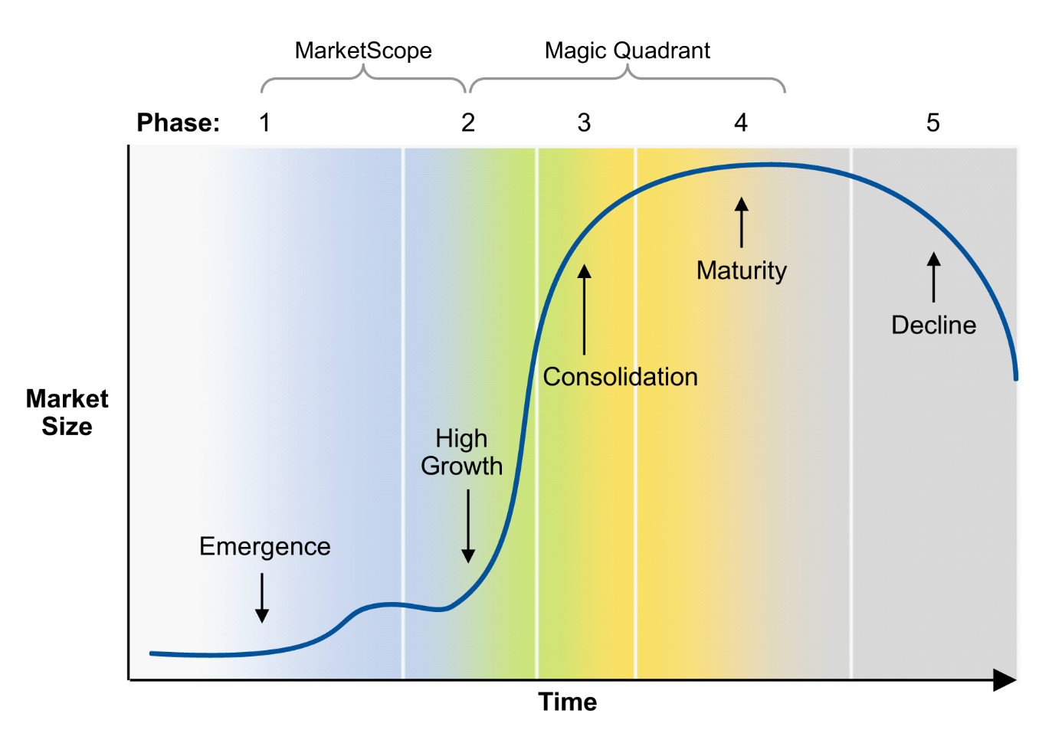
Piaci életciklus

Slide 13
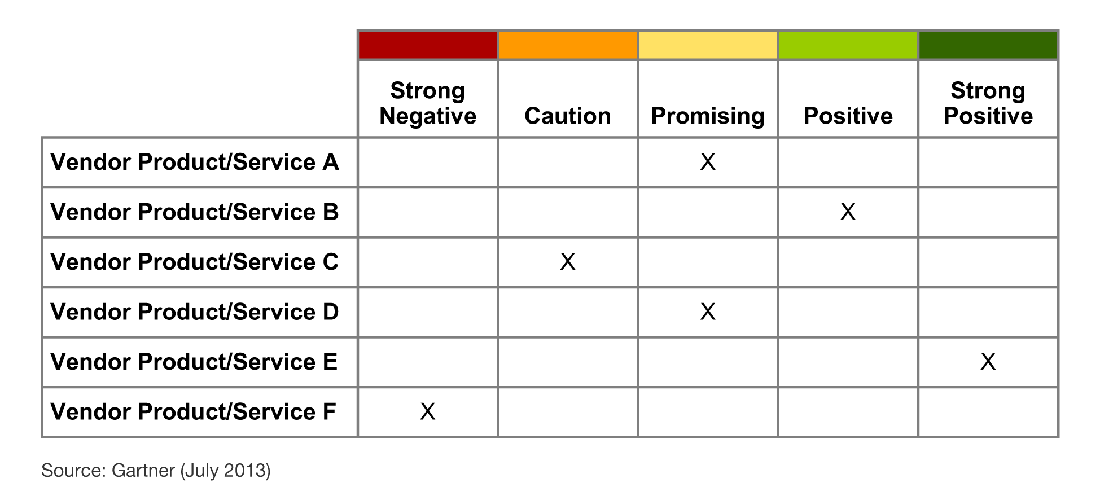
MarketScope

Slide 14
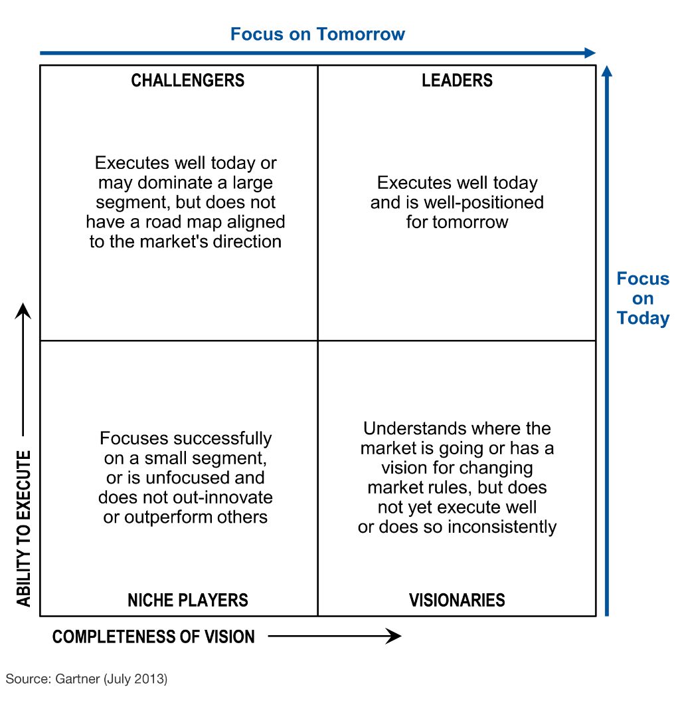
Magic Quadrant

Slide 15
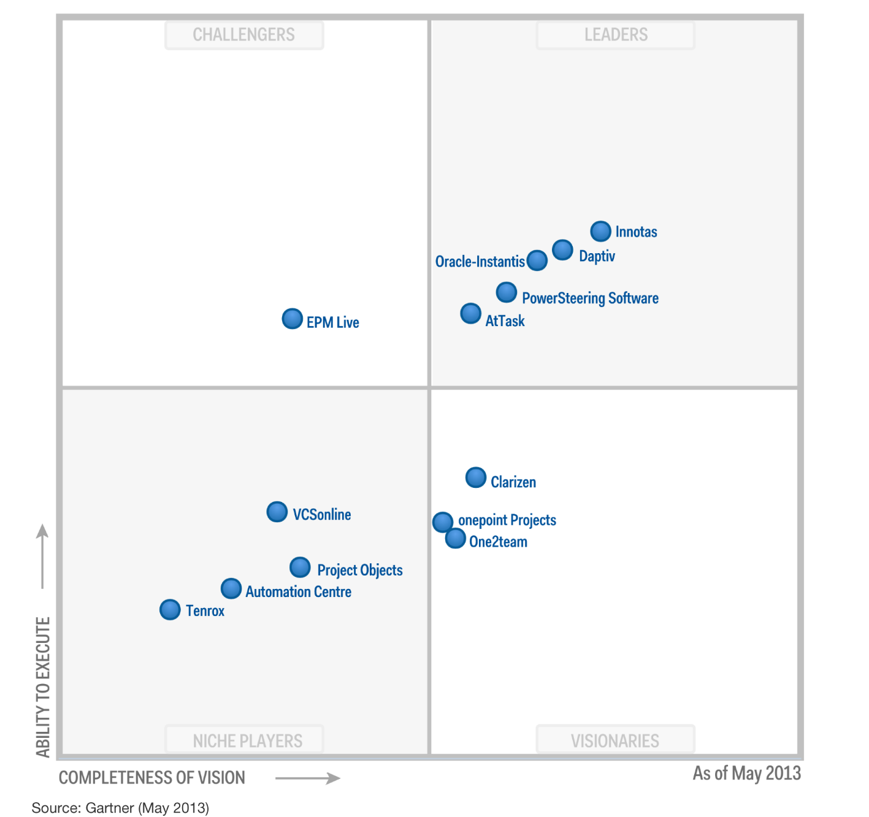
Magic Quadrant for Cloud-Based IT Project and Portfolio Management Services

Slide 16
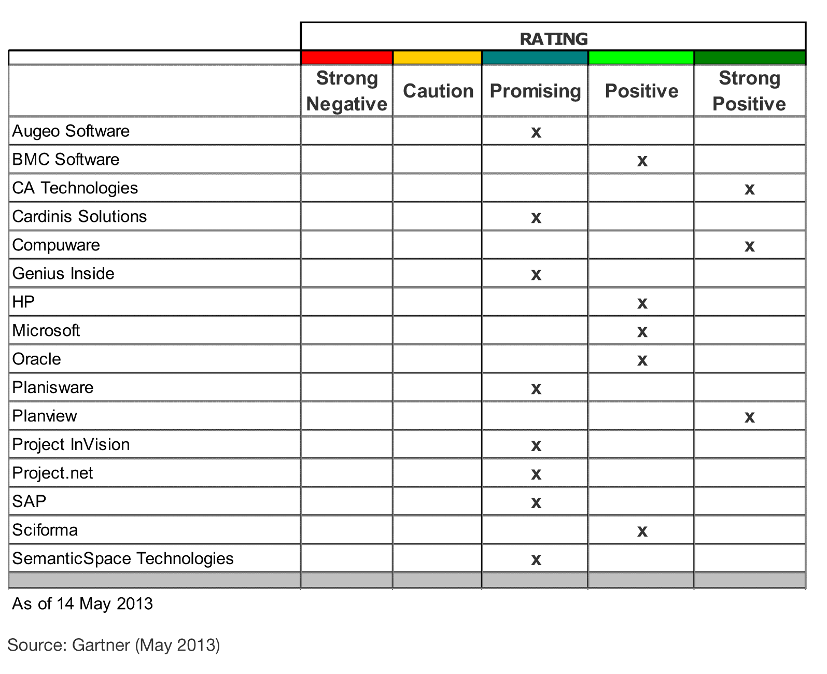
MarketScope for IT Project and Portfolio Management Software Applications
Notes:
SaaS configuration times, effort and cost of the products in this MarketScope are often comparable
to those of on-premises deployment of the same.

Slide 17
Ajánlott Gartner elemzések
ITScore for Program and Portfolio Management Lars Mieritz (G00247478)
MarketScope for IT Project and Portfolio Management Software
Daniel B. Stang, Robert A. Handler (G00247057)
Magic Quadrant for Cloud-Based IT Project and Portfolio Management Services
Daniel B. Stang, Robert A. Handler (G00247058)
For more information, stop by Gartner Research Zone.

Slide 18

Németh János Pál
+36 30 265 9999
Janos.Pal.Nemeth@gartner.com
ITango – Gartner Magyarország
www.gartner.com
itango.hu

